Slide 1
Initial feasible solutions of the transportation problem

Slide 2
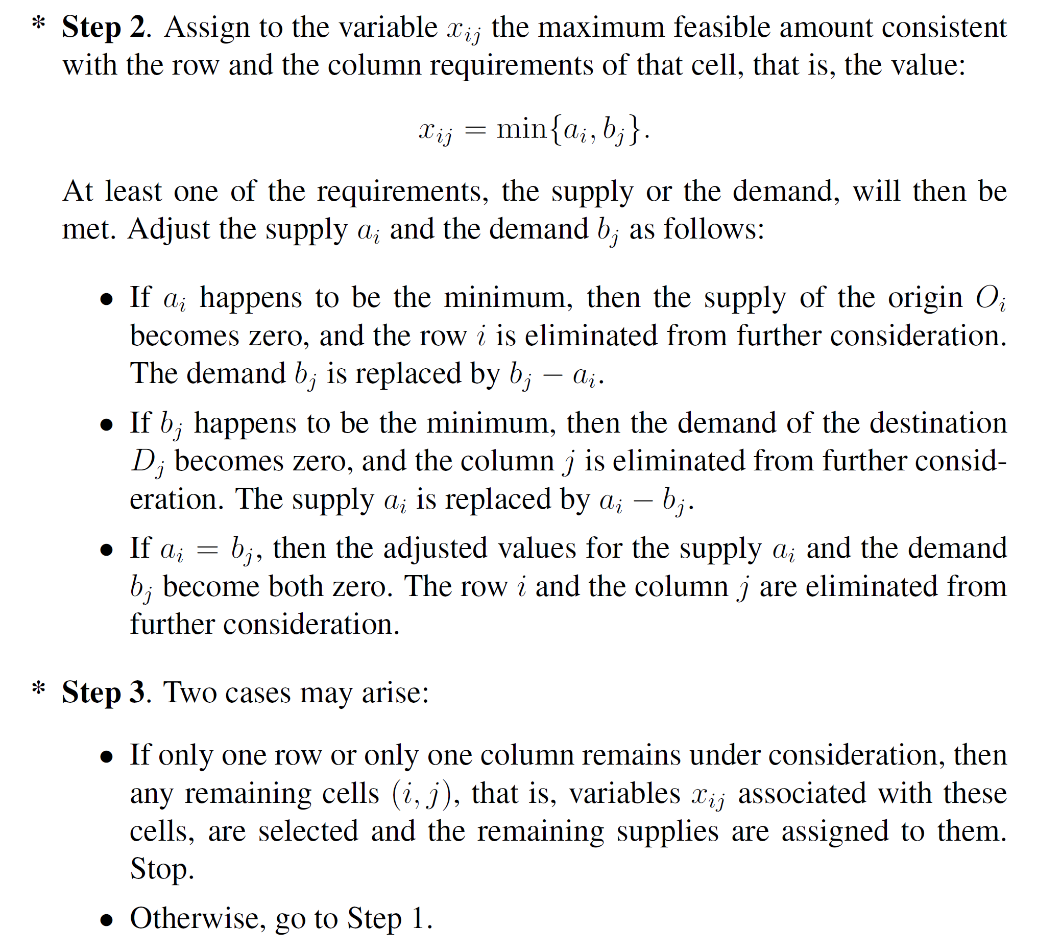
NW Corner method

Slide 3
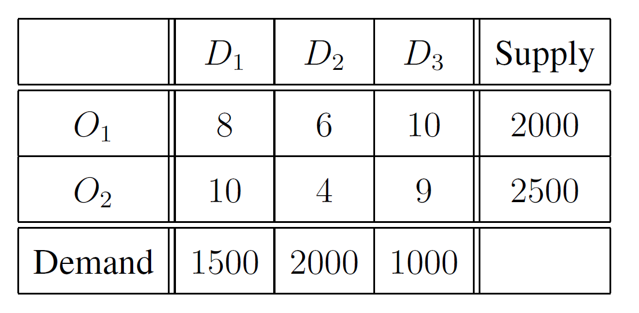
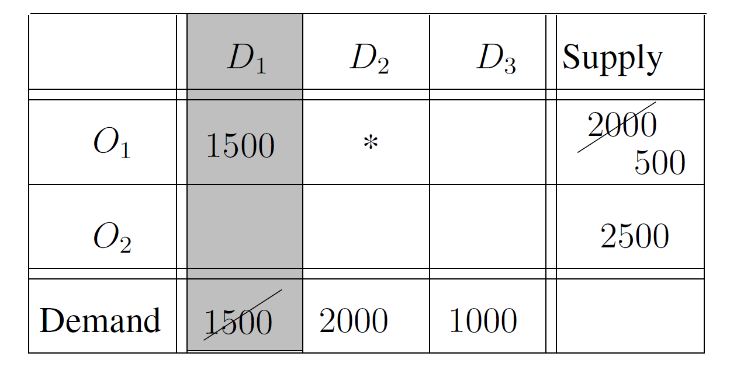
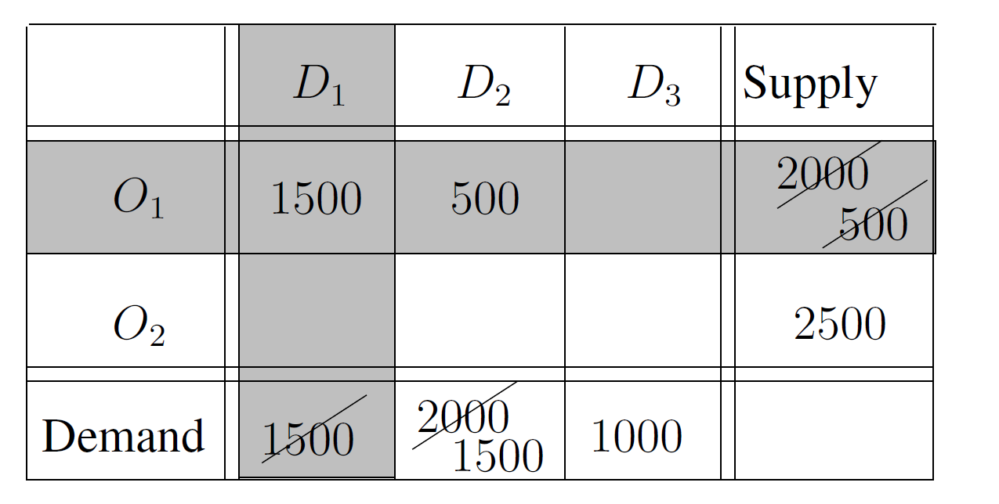
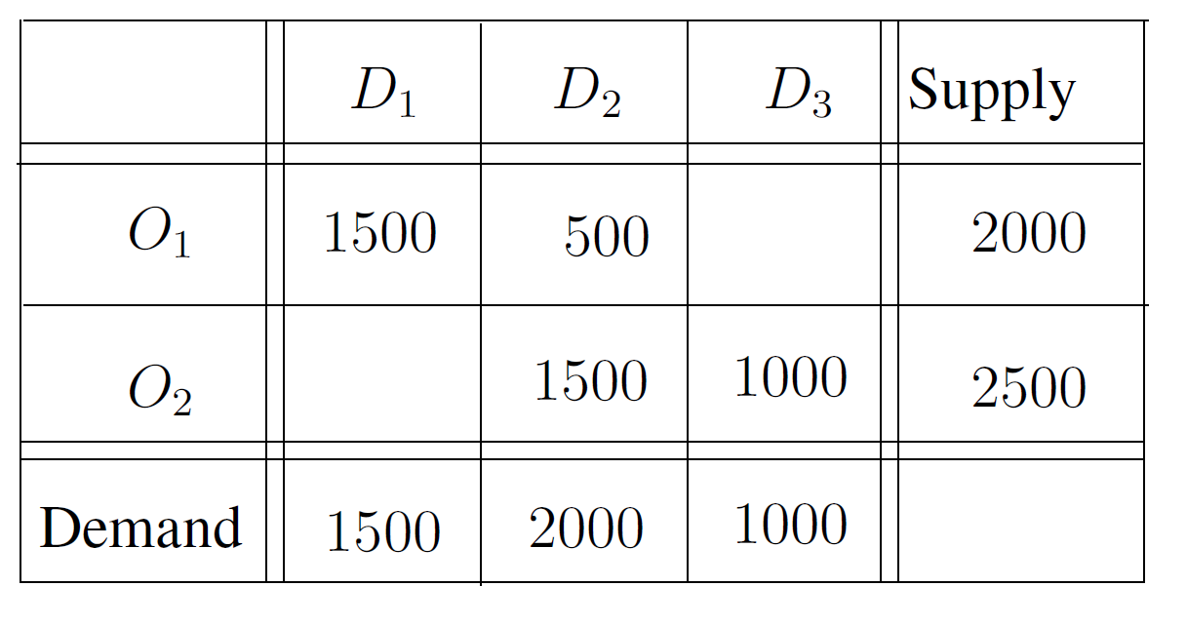
NW Corner method - example

Slide 4
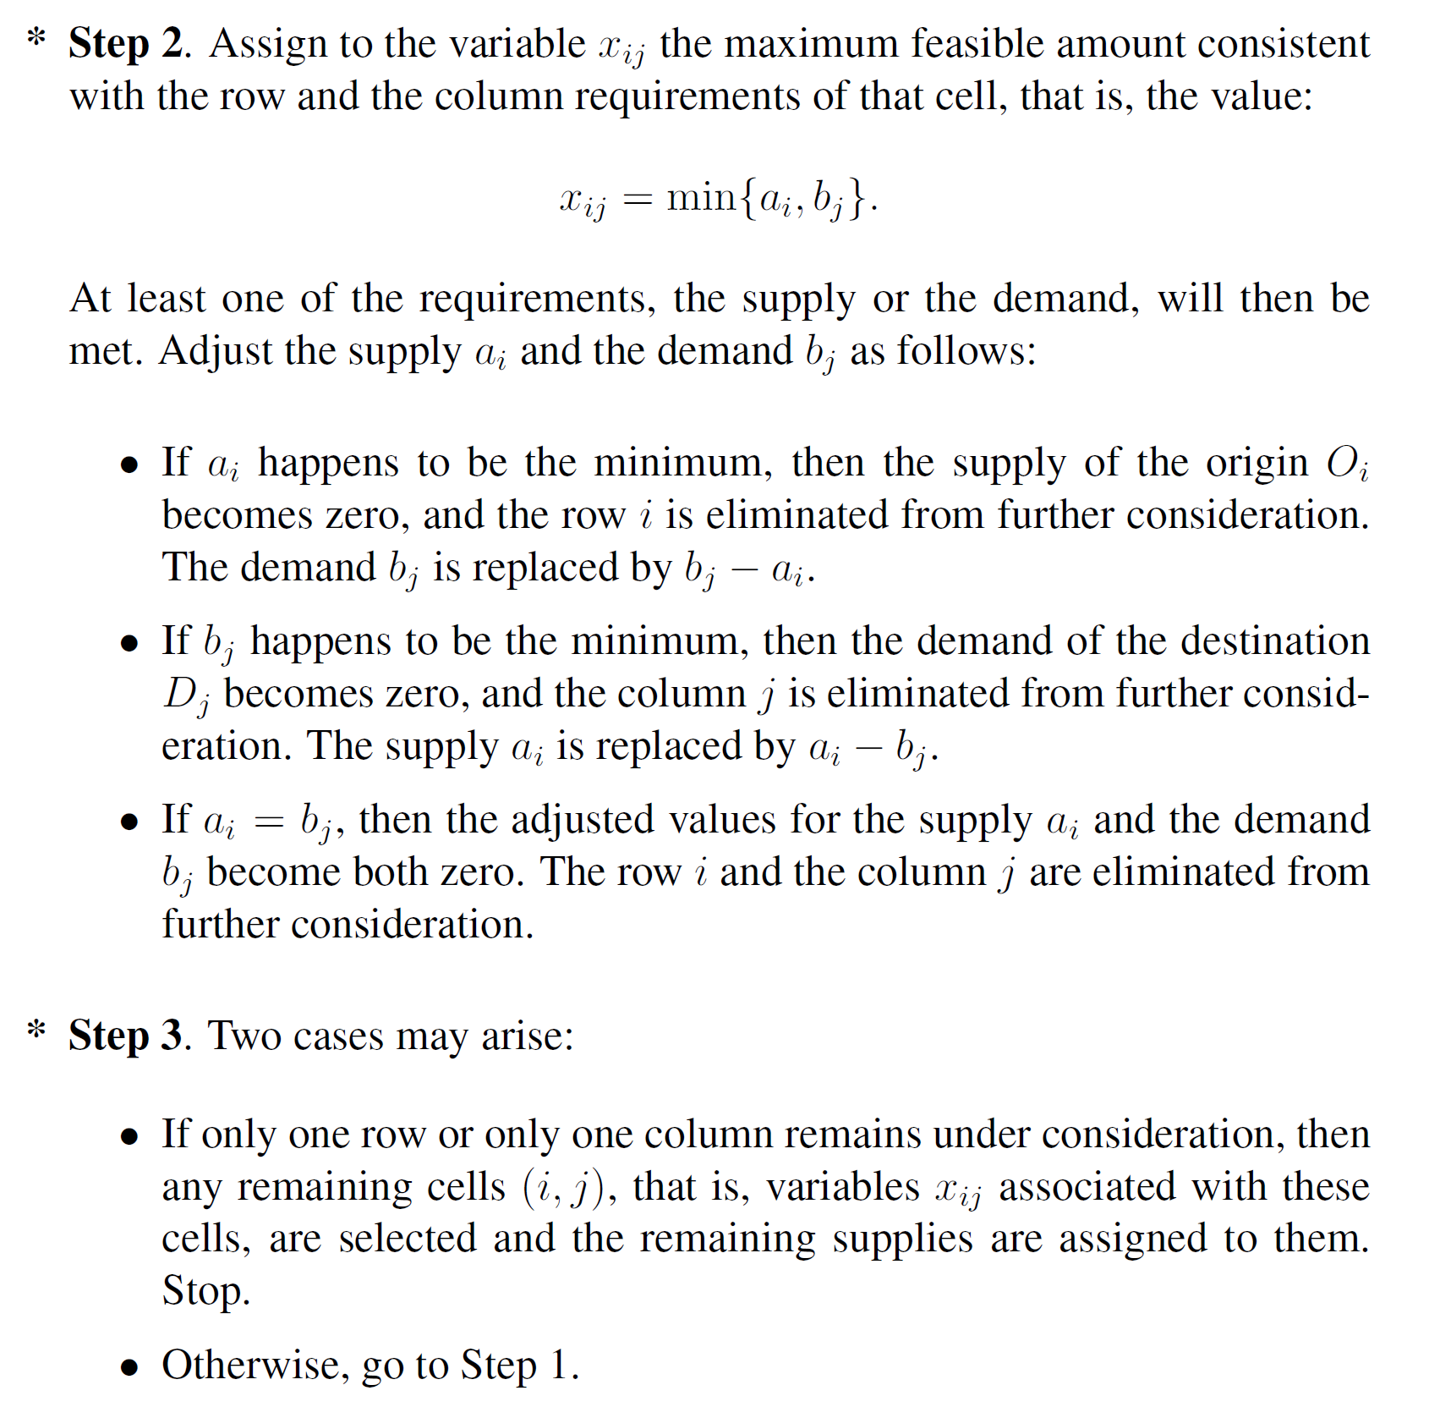
Vogel’s approximation method
1. Find the two smallest cost values in each row and column of the cost matrix. Subtract the smaller value from the larger one to get the "penalty cost" for that cell.
2. Select the row or column with the highest penalty cost, and assign the largest possible shipment to the cell with the smallest cost in that row or column. If there are multiple cells with the same smallest cost, choose one arbitrarily.
3. Recalculate the penalty costs for all the rows and columns affected by the shipment, and repeat steps 2 and 3 until all the demand and supply values are satisfied.
These steps are repeated until all demand and supply constraints are met, resulting in an initial feasible solution to the transportation problem.

Slide 5
Vogel’s method - example

Slide 6
Russell’s approximation method
Find the cell with the lowest cost in the cost matrix and assign the largest possible shipment to it. If there are multiple cells with the same lowest cost, choose one arbitrarily.
Recalculate the costs for each row and column affected by the shipment, as well as any other cells that have not yet been assigned a shipment. The recalculated cost is equal to the original cost minus the cost of the assigned cell.
Repeat steps 1 and 2 until all the demand and supply values are satisfied.
These steps are repeated until all demand and supply constraints are met, resulting in an initial feasible solution to the transportation problem.
Unlike Vogel's Approximation Method, Russell's method does not take into account penalties for unassigned cells, and instead focuses on minimizing the cost of each individual shipment.

