Slide 1
Safety of information systems Cryptography
Roman Danel
roman.danel@vsb.cz
VŠB – TU Ostrava

Slide 2
Cryptology and cryptography
Cryptology - a discipline, dealing with the creation, use, drawing or breaking of ciphers
Cryptography – the science of cipher formation, studying cryptographic algorithms, tools, protocols …
Cryptoanalysis – breaking, breaking cipher
Steganography – hiding messages (not the content)

Slide 3
Encryption
Encyption - Encryption of the transmitted information so that it is not comprehensible to a third party.
Key – secret information without which the encrypted text can not be read.
Hash Functions – A way to create a short string throughout the text that uniquely identifies the original text.

Slide 4
Hash
A one-way function that creates an x-bit length (hash) from an arbitrary long message.
From the output of this function, we are unable to generate input - the original message can not be derived
Hash functions - eg SHA (Secure Hash Algorithm), SHA-xxx where xxx is the length in bits
MD5 (Message-Digest Algorithm 5) - 128b

Slide 5
SHA
Designed by the National Security Agency in the US (part of the FIPS)
SHA-1 – hash of a message of 160 bits
Used for SSH, SSL, Ipsec, etc.
2001 - SHA-2

Slide 6
Encryption types
Symetric
Stream ciphers (Fish, RC4, …)
Block ciphers (AES, DES, …)
It uses a single key to encrypt and decrypt – private
Asymetric
Private and public keys.

Slide 7
Symetric encryption
Stream Cipher - This is a symmetric based encryption. This encryption is incrementally bit-by-bit using the encryption key, ie each bit is encrypted in particular, and when decrypted, each bit is again decrypted and then merged to the output form - such as a document file.
Block ciphers - This is a more advanced encryption that divides the default bit sequence into bit words and then appropriately complements the bit cipher so that all words are the same size. Most recently 64 bit and 128-bit encryption has been used, and services that require 256-bit encryption have begun to appear.

Slide 8
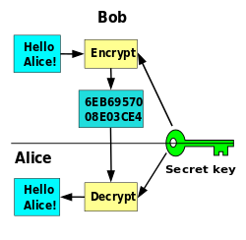
Symetric Key

Slide 9
Asymetric encryption
Uses Private and Public key
The sender -> encodes with the public key he has received from the recipient
The recipient -> decrypts with private key

Slide 10
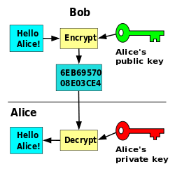
Asymetric Key

Slide 12
Disadvantages of asymetric
More complicated key creation
The downside is speed - slower than symmetrical
Less resistant to brute force attack
Need to verify the authenticity of the key

Slide 13
Digital Signature
Asymmetric key - private key signature
For a symmetric key, anyone who can authenticate the code, can generate it at the same time
The nonrepudiation of the authorship of the signed text is ensure
Authentication - application using sender public key - decrypting gets a hash that compares with hash of sent messages

Slide 14
Certification Authority
Anyone accepting certificate requests - verifies, issues, renews, revokes certificates, and publishes a list of invalidated certificates
Trusted CA - root certificate in browser repositories (paid service)

Slide 15
What is a „certificate“?
A file with a structure described in ASN.1 language – contains information about publisher, owner, expiration date, and public key

Slide 16
Content of Certificate
Version – V1, V2, V3
Serial number - Certificate number for a given Certificate Authority (CA) for easier tracing
Algorithm of signature - what algorithm was used
Issuer - the name of the CA
Certificate validity - from when the certificate is valid
Entity - for whom the certificate is issued
Public key - mostly RSA (1024 Bits or 2048 Bits)
Using the key - what it will be used for (signing)
Thumbnail algorithm - SHA1 or SHA2
Thumbnail - Certificate hash
Source: http://www.cleverandsmart.cz/

Slide 17
Certificate
The CA certificate will be electronically signed by its root certificate, respectively encrypts it with its private key.
By doing so, the CA confirms that the information on the certificate is true at the time the verification was made.

Slide 18
Certificate classes
Class 1 - The entire process of issuing the certificate is online, and the applicant is not have been checked
Class 2 - Checks the identity of the applicant who must appear personally
Class 3 - the identity of the applicant is checked and the certificates are intended for a specific purpose only

Slide 19
System certificate
To identify the server and establish a secure encrypted connection (SSL / TLS)
Signing messages that will send from this server.

Slide 20
Security of the certificates
Access „defense in depth“
HSM - Hardware Security Module - Network-accessible HW certified by Common Criteria - access only by authorized persons
Government institution - only recognized electronic signatures with a qualified certificate from an accredited certification authority

Slide 21
FIPS
Federal Information Processing Standards
Public standards of USA governmenet, e.g.:
FIPS 46 – standard for usage of DES
FIPS 197 – standard for AES
FIPS 140-2 – security of cryptographic systems
FIPS 180-2 – Digital Signature Algorithm

Slide 22
Common Criteria
Common Criteria for Information Technology Security Evaluation
Standard for computer security certification
Ensures that the process of specification, implementation, and evaluation of a computer security product will be conducted in a strict and standardized way

Slide 23
History of cryptography
Steganography – hiding of texts - invisible inks etc.
Coding – without password, only required knowledge of the code table:
Ancient – substitution cipher - the character is replaced by another character according to the rule
Caesar Cipher - Ancient Rome - Each letter of the message is bent on a fixed number of positions

Slide 24
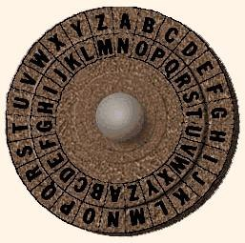
Caesar Cipher - substitution
Source: http://invisiblecomputer.wonderhowto.com/inspiration/introduction-cryptography-archaic-beginnings-0133735/

Slide 25
History of cryptography
Tables of substitutions – characters substitution without any internal context
Vigener‘s Cipher – Caesar Cipher enlargement, 16th Century
The variable length is used to move the text
The character shift in the alphabet based on the password, ie for each occurrence of the character differently
Broken by Charles Babbage

Slide 26
Vernam's cipher
Vernam Cipher - Added to open text and password, the password is a random block of the same size as the open text
The only inexplicable but difficult job
„One-time pad“ - a one-time table cipher

Slide 27
History of cryptography
Transposition ciphers - change the order of characters according to a rule
Combined ciphers
Encryption by machine - Enigma
Modern symmetric ciphers - DES, AES
Encryption - XOR (Exclusive Sum)
Quantum cryptography

Slide 28
Enigma
Main Components - Keyboard, Interface Board, Scrambler, Mirror, Cipher Display.
Principle - scramblers are rotating and change the cipher letter after pressing each key. The interconnection plate exchanges pairs of characters. Number of combinations of about 10¹⁷.
Broken for World War II - Alan Turing

Slide 29
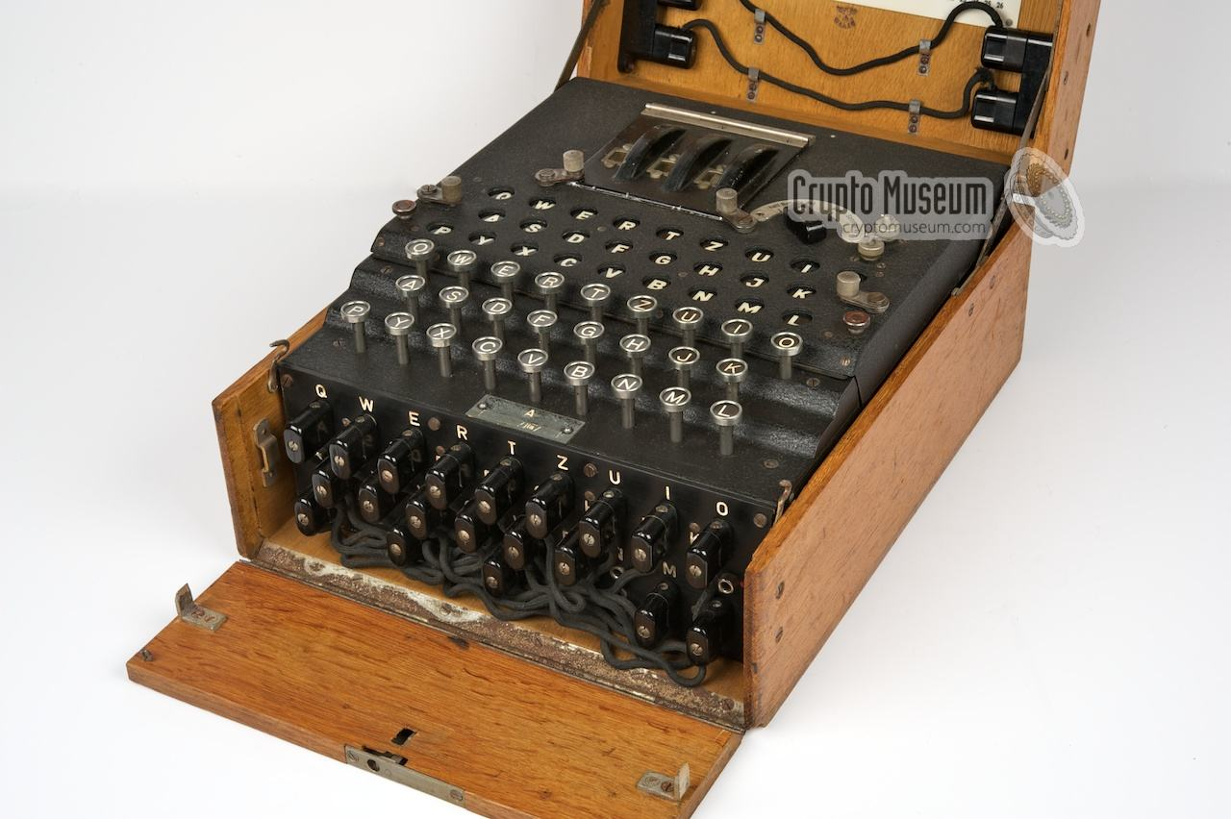
Enigma
Source: http://cryptomuseum.com/crypto/enigma

Slide 30
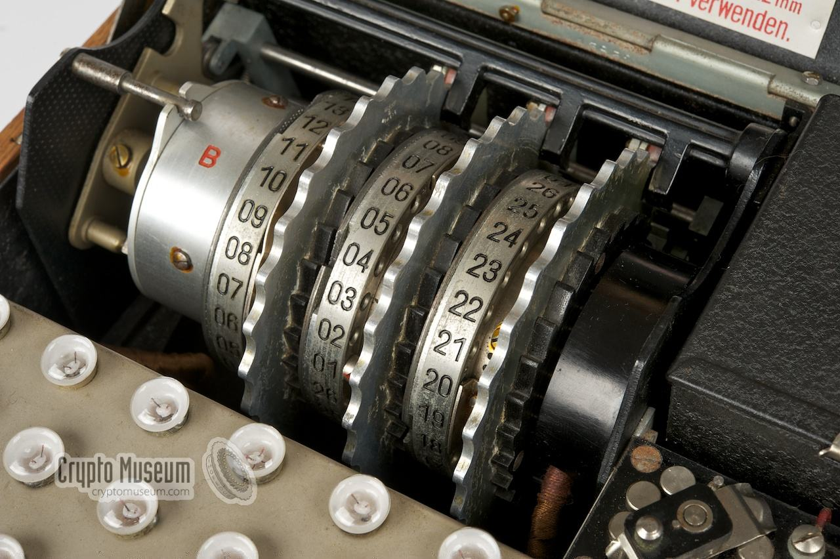
Enigma

Slide 31
DES
DES – Data Encrypted Standard
DES was developed in 1977 and is considered to be inadequate as it uses only 54 bits for encryption
The cipher can be cracked using a brute force method in approximately 24 hours by the standard computer of today.
Feistel's cipher

Slide 32
Blowfish
Blowfish - The cipher is a work of B. Schneier and was first published in 1994. It is a cipher with a block size of 64 bits and a key length of at most 448b (ie 56B). The author created this cipher as an unlicensed unlicensed alternative to DES, but unlike DES, it has not been broken yet

Slide 33
Blowfish
Symmetric block cipher
The algorithm consists of two parts:
Key Expansion - Converts a key with any length to several subkey fields, these subkeys must be pre-calculated, computationally demanding
Data encryption - 64-bit blocks in 16 rounds, runs fast
All operations used in the algorithm are XOR and addition of 32-bit words

Slide 34
Advantages and disadvantages of blowfish
One of the fastest block cages with wide use
Each new key needs preprocessing the same as encryption of 4 kilobytes of text, which is very slow compared to other block ciphers. This prevents use in certain applications.
Yet provides sufficient protection against "dictionary attacks"

Slide 35
Usage of blowfish
t is not suitable for encryption of large databases
Keys occupy 4 kB => Can be used on older computers
Software to encrypt documents on CDs, flash drives, smart cards
PuTTY: A Free Telnet / SSH Client

Slide 36
Twofish
Blowfish folower
Key up to 256 bits
Free available
Usage: PhotoEncrypt, GPG and open source software TrueCrypt.

Slide 37
AES
AES – Advanced Encryption Standard
It was created by the US government to encrypt its documents.
The key size can be 128, 192 or 256 bits - it has not been broken yet.
Used in WiFi (WPA2 security)
1997, 2002 - US federal standard

Slide 38
AES
A brute force attack against AES with a 256-bit key would require 2²⁰⁰ operations, so the total calculation would take much longer than the overall age of the universe.

Slide 39
Asymetric cipher
Use 1 - to encrypt the recipient's public key, to decrypt the private key of the recipient. The message reads ONLY the authorized recipient
Use 2 - to encrypt the private key of the sender, to decrypt the public key of the sender. The recipient demonstrates the identity of the sender (eg electronic signature ...)

Slide 40
RSA
Asymmetric encryption
Public and private key
http://www.cleverandsmart.cz/zaklady-kryptografie-pro-manazery-rsa/

Slide 41
PGP
Pretty Good Privacy, 1991
Based on RSA, digital signature, a combination of symmetric and asymmetric encryption
OpenPGP Internet Standard
GnuPGP - Linux
Message digest - ensuring authenticity
http://www.pgpi.org/

Slide 42
Attacks
Bruce Force Attack
Most versatile
All possible combinations are tested
MIPS - Million operations per second
8 bit key – 256 ms within speed 1 MIPS
128 b key – 5.10²⁴ years

Slide 43
Attacks
Cipher Only Attack Knowledge
Known Plaintext Attack
Cracking with Selected Open Texts (Chosen Plaintext Attack)
Cracking with taking knowledge of selected encrypted texts
Cracking with user compromise
Timing Attack

Slide 44
PKI
PKI (Public Key Infrastructure) - the infrastructure of administration and distribution of public keys from asymmetric cryptography.

Slide 45
What does PKI involve?
digital certificates
encryption keys
asymmetric cryptography
certification authority
network security architecture
way of safe issuance of certificates
tools for managing, restoring, and deleting certificates

Slide 46
Electronic Signatures
An electronic signature is used to ensure of the author and the integrity of signed data.
The electronic signature is the application of asymmetric cryptography (ie. Public-key cryptography).
Czech Republic: Act no. 227/2000 Coll.

Slide 47
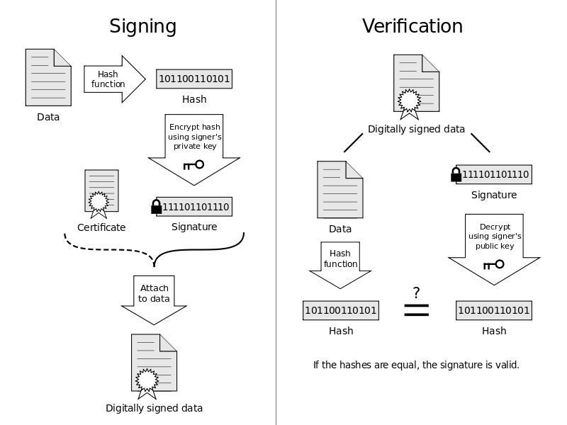
Electronic Signature

Slide 48
Data Boxes (Czech Republic)
The data box is in the Czech legal system since 2009, defined as an electronic repository special type established under the Act no. 300/2008 Coll., which is designed to deliver electronic documents between public authorities on the one hand, and natural and legal persons on the other side (January 1, 2010 natural and legal persons among themselves).
The data box is mandatory for state authorities and legal persons registered in the Commercial Register is voluntary for most employed individuals, it may establish and residential customers.

