Slide 1
Safety of information systems Authentication, Authorisation, Biometrics
Roman Danel
roman.danel@vsb.cz
VŠB – TU Ostrava

Slide 2
Autentization
Authorization
Audit

Slide 3
Authentication methods
Password (PIN, code…)
Token – key, card…
Biometrics

Slide 4
Basic terminology
Recognition
Verification – one-to-one identity verification
Identification – identifying an unknown individual - the information is compared to all one-to-many (s)
Authentication – authentication - user gets status (authorized, unauthorized ...)

Slide 5
The process within biometric systems
Acquisition of a data file with a biometric property
Checking data quality
Extract a biometric quantity from a data file - create a sample template
Sample Template Entry into Template Archives
Compare current template with reference and generate a score
If the score exceeds the set limit, access is enabled

Slide 6
Suitable properties for biometrics
Uniqueness
Versatility – Universal for a large set of people
Permanence – it must not change over time
Measurability
User Acceptance
Circumvention

Slide 7
The properties used
Fingerprint - structure of the papillary lines and their details
Signature Dynamics - differences in pressure and writing speed
Face geometry - distances of specific parts - eyes, nose, mouth ...
Iris of the eye - image of the iris
Eye retina - structure of veins on ocular background
Hand geometry - palm and finger dimensions

Slide 8
The properties used
Structure of veins on the wrist
Ear shape - dimensions of the visible part of the ear
Voice - tone and tone of voice
DNA - the chain of deoxyribonucleic acid
Smell - chemical composition (dogs ...)
typing on keyboard - rhythm of strokes on PC keyboard

Slide 9
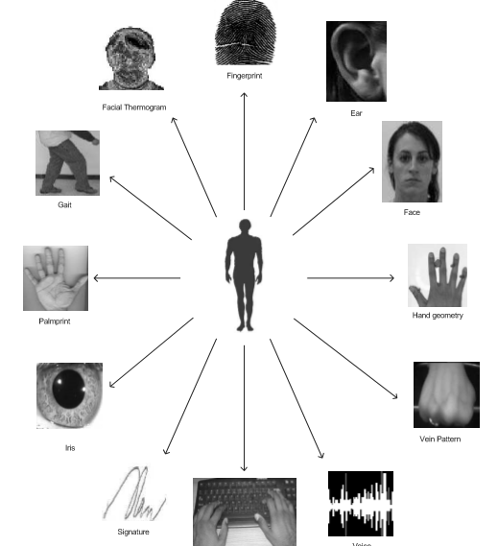
The properties used for biometrics

Slide 10
Methods of formation of biometric characteristics
through genetic development: the influence of inheritance (DNA) - genotyped
through random variants of early embryonic development - randotypic
through learning and education: individual behavior - behavioral

Slide 11
What can affect biometric properties
Aging
Growth of living tissue
Injury
Dirt

Slide 12
The optimal method?
Price and accuracy ratio - fingerprint
Eye iris - if costs does not play significant role
DNA - small sensing comfort, single twins have identical DNA ...
Notes:
Oční duhovka

Slide 13
Performance measures
Incorrect acceptance factor
Improper rejection coefficient
Coefficient of error
Verification time

Slide 14
Measurable Biometric Validation Values
FAR - False Acceptance Rate
probability of mistaken acceptance
FRR - False Rejection Rate
probability of wrong denial
Ideal sensor: FAR = FRR = 0.

Slide 15
False Acceptance Rate (FAR)
The probability that an unauthorized person is accepted as legitimate
Indicates the degree of security
Error of acceptance a person who does not normally have access to the system under normal conditions
FAR 0.001% corresponds to a ratio of 1: 100,000

Slide 16
False Acceptance Rate
𝐹A𝑅 = 𝑁_{𝐹A} / 𝑁_{II𝐴} [%]
N_{FA} - Number of False Acceptance
N_{IIA} - Number of Impostor Identification Attempts

Slide 17
False Rejection Rate (FRR)
The probability that a legitimate user is declined by the system
Indicates comfort of the system
It is of little importance from a safety point of view
Important within marketing - dissatisfaction

Slide 18
False Rejection Rate
𝐹𝑅𝑅 = 𝑁_{𝐹𝑅} / 𝑁_{𝐸𝐿𝐴} [%]
N_{FR} - Number of False Rejection
N_{ELA} - Number of Enrole Identification Attempts

Slide 19
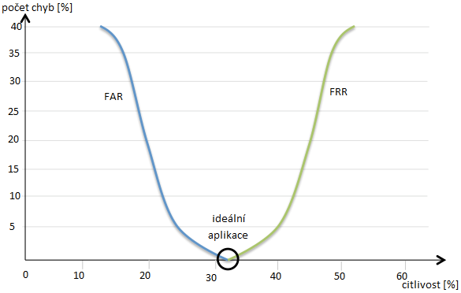
Relationship between FRR and FAR - ideal
Source: http://www.posterus.sk/?p=11511#

Slide 20
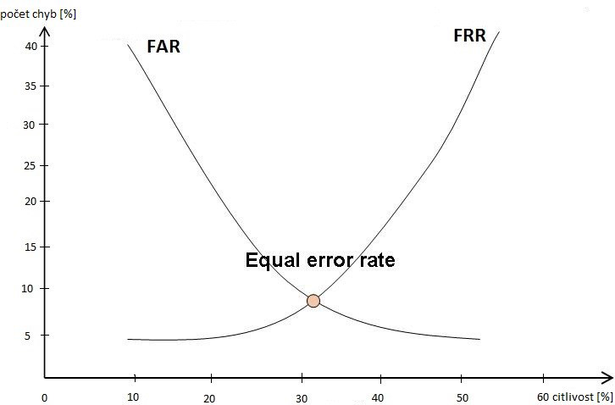
Relationship between FRR and FAR - real

Slide 21
Other coefficients
Failure to Enroll Rate (FTE)
indicates the ratio of people who have failed to process the biometric property
False Match Rate (FMR)
indicates the ratio of unauthorized persons that are incorrectly recognized as an accredited during the comparative process
False Indentificaion Rate
indicates the likelihood that in the identification process the biometric property is improperly assigned to a reference sample.

Slide 22
False Non-Match Rate (FNMR)
indicates the ratio that authorized persons are not misidentified during the comparative process.
Compared to the FRR, it differs in that there are not counted the rejections caused by the poor quality scan of the image.

Slide 23
Effectiveness of systems: Cross coefficient
Cross coefficient – Equal Error Rate (EER)
What is the probability in which setting of the decision boundary occurs FAR and FFR at the same time (FAR = FFR).
Important in setting system sensitivity
FAR-safety, FFR-comfort – at the point of balance is the best system setup

Slide 24
Multiple Biometrics
Multiple biometrics
Most often: fingerprints, face geometry, eye iris (retina) geometry and voice

Slide 25
Overview of methods

Slide 26
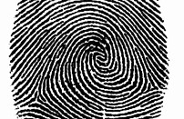
Fingerprints
The best known method Databases already exist High percentage of usable population

Slide 27
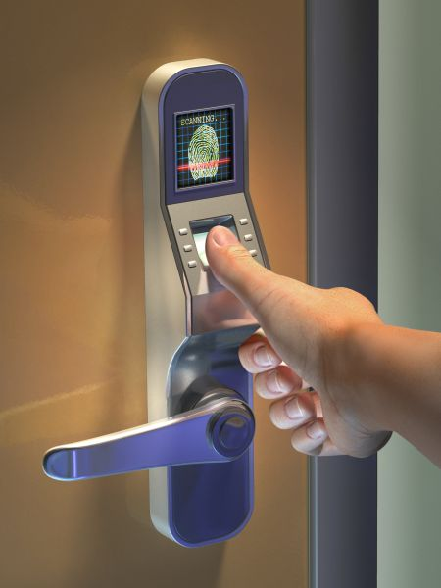
Fingerprint readers
Optical sensors
Electro-optical
Capacitive sensors
Silicon chips and capacitance sensor
Pressure sensors
Conductive membrane on silicone
Conductive membrane on TFT
Touch micro-electro-mechanical switches
Radio sensors
Temperature sensors
Ultrasonic sensors
Photonic crystals
Surface impedance sensors

Slide 28
Fingerprint readers
TST – Touchless Technology – optical contactless - LED, CMOS
Transmitting optical sensors - scanning light beams passing through the finger of a hand, which from the top is illuminated by a omnidirectional light source (usually the classic infrared LED)
CCD or CMOS for processing
TFT (Thin Film Transistor)

Slide 29
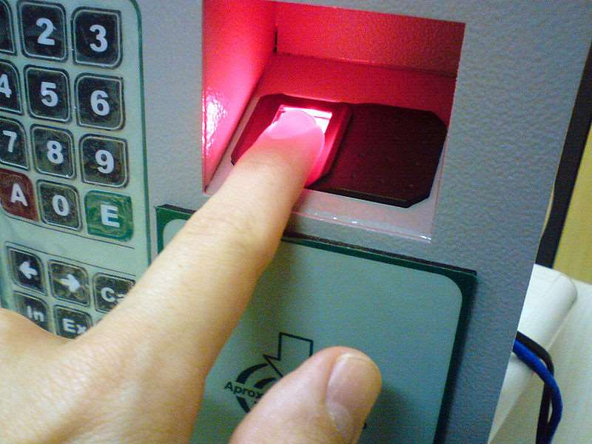
Fingerprint readers
Electro-optical - polymeric materials capable of emitting light when energized by a suitable voltage + CMOS camera - the material emit light only in the places where the finger touches it - ie at the points of contact of the papillary lines
Ethentica, TesTech

Slide 30
Capacitive fingerprint readers
Measures the capacity between finger skin and active pixels
Size of the measured el. the field varies between the ridges of the papillary lines as a cause of the dielectric change between one capacitor plate (pixel) and the second plate of the capacitor (finger)
Dielectric is the air layer or the skin of the fingerprint

Slide 31
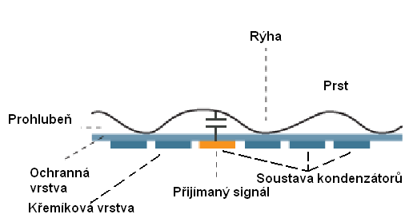
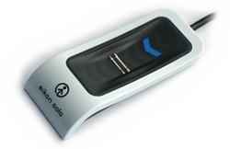
Capacitive fingerprint readers
Small Sensor Dimension (4 cm²)
Scanning device: CMOS camera, TFT display
High precision

Slide 32
Radio fingerprint readers
To the finger, a low RF (Radio frequency) transmitter transmits a radio signal that is scanned by a miniature antenna matrix
Signal strength - will be different at the point where the finger directly touches the sensor (the lines of the papillary lines) and where it does not touch it (the papillary recesses)

Slide 33
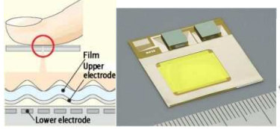
Pressure fingerprint readers
Piezoelectric materials
Conductive membrane (piezoelectric pressure sensor matrix)

Slide 34
Thermal fingerprint readers
Thermal sensing works on the principle of measuring slight differences in temperature between the skin of the finger and the air that fills the space between its papillary fingertips.

Slide 35
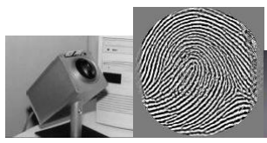
Ultrasonic fingerprint readers
It measures the reflected sound wave
Sonar principle
Advantage: penetrates with dirt
Higher prices
Ultrascan

Slide 36
CASE STUDY - ARDAGH

Slide 37
Hand geometry
Measurement and 3-dimensional scanning of the length, width, thickness and surface of a person's hand located on a pad with five positional pins
The hand image has 31,000 point points
One of the oldest methods
Still the norm is missing

Slide 38
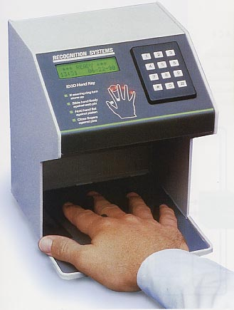

Slide 39
Face geometry
Compare the scanned image with the image in the database
Face shape and position of optically significant places (eyes, nose, mouth ...)
Image - brightness matrix with reduced data redundancy

Slide 40
Face geometry
Face recognition algorithms:
Principal Component Analysis (PCA)
Linear Discrimination Analysis (LDA)
Elastic Bunch Graph Matching (EBGM)

Slide 41
Face geometry - errors
Effect of shooting angle
Influence of lighting
Influence of ambient temperature

Slide 42
3D face readers – Brodway 3D

Slide 43
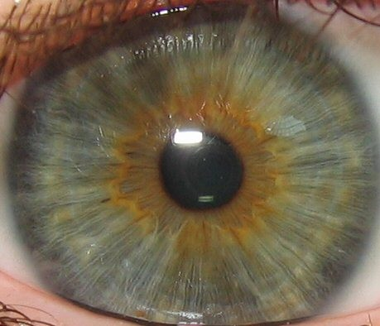
The iris of the eye
Patent 1994
Iris - a muscle in the eye that regulates the size of the lens and thus focuses the eye
The coloration corresponds to the amount of melatonin pigment
Sampling is random and therefore unique (both eyes - one person) - one of the most accurate methods!
Notes:
Duhovka

Slide 44
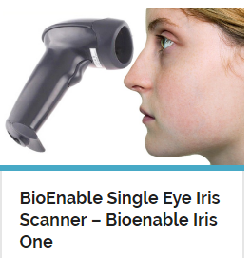
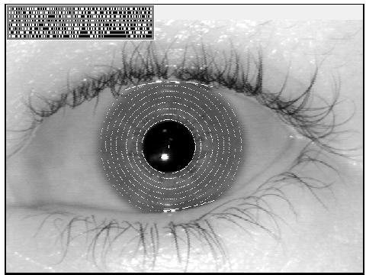
The iris of the eye
Shooting: high quality camera and infrared illumination -> phasor diagrams (information, orientation and frequency of watched items) -> iris map
Verification - comparison of the iris map with the reference sample

Slide 45
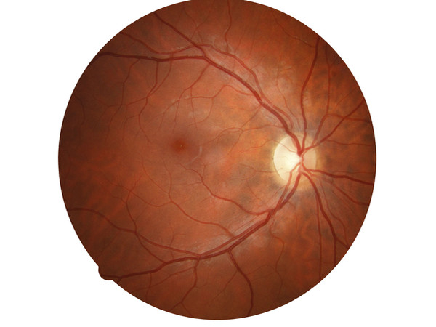
Retina of the eye
Retina - light-sensitive surface on the back of the eye
An image of the structure of blood vessels on the background of the human eye around the blind spot is used
Susceptible to sensitivity - risk of dangerous eye irradiation
The user must look into the "well-defined" space
Problem with glasses

Slide 46
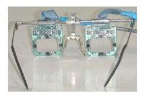
Verification based on eye movement
University of Gliwice, Poland
Using special glasses
It is not used commercially yet

Slide 47
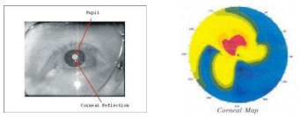
Surface topography of the cornea
low power infrared light (emitted by LED) aimed at the center of the lens illuminates the eye - the light is reflected from the cornea and by the intensity of the eye reacts - the reaction is different for each individual
Notes:
Topografie rohovky

Slide 48
The structure of the veins on the wrist
A new method for the year 2000
High difficulty of forgery
Capturing the back of the hand with the camera in infrared light (hand must be warm = lively human)
The image of the tree structure of the veins is a formula
Contactless
Notes:
Žil na zápěstí

Slide 49
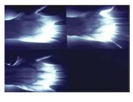
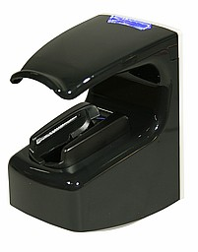
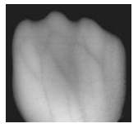
The structure of veins in the wrist
Non-contact sensor - infrared beam - deoxidized hemoglobin creates a network of darker lines

Slide 50
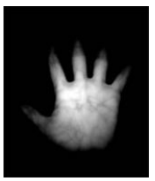
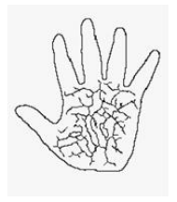
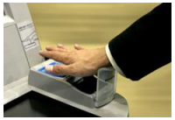
The structure of veins in the palm
Infrared

Slide 51
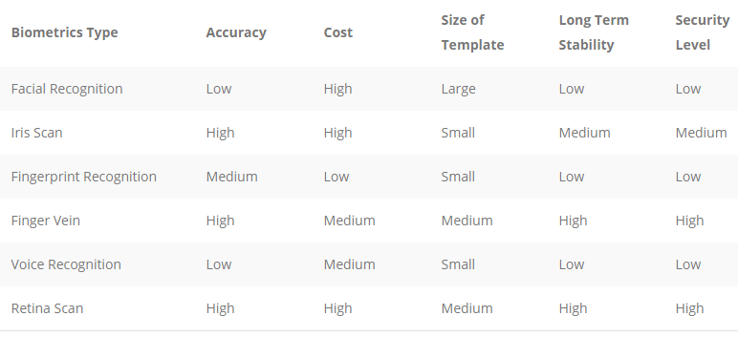
Method comparison

Slide 52
The shape of the finger and fist
Measure finger joints on the palm of your hand in the outside Up to 35 parameters are tracked

Slide 53
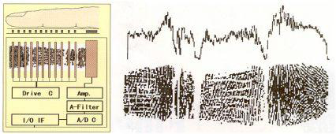
Fingering of fingertips
Toshiba, 1998
Electrostatic capacitive reactivity of wrinkle measurement under two finger joints in hand

Slide 54
Typing on the keyboard
It is being watched
keystroke dynamics,
the length of time the keys are held
delay between prints
Non-invasive, well-received
Algorithms - pattern matching, neural network

Slide 55
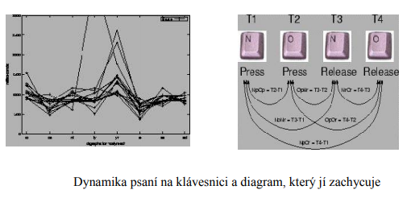
Typing on the keyboard
Longer evaluation time
Writing dynamics varies with time

Slide 56
Motion dynamics of the mouse
Queen Mary University, London
The user draws a certain shape - etalon - 20x, of which an average is created and it is converted to 144 vectors
SW verifies the position, stroke speed, rounding, and compares the shape with the standard

Slide 57
Signature Dynamics
1977
Stroke, shape, pressure
Dynamic Features: Speed, Acceleration, Stroke ...

Slide 58
Dynamics of walking
Two leg movement - bipedal locomotion
Application in forensic sphere
Compares curves that describe certain points on the human body

Slide 59
The acoustic characteristics of the voice
Pre-stored voice samples and combinations with key sentences - Voice immitators without knowledge of key phrases can not oblige the system
Old forensic method
There is no suitable sensor in the real environment with noise

Slide 60
Verification by smell
Human smell consists of approximately thirty chemical compounds whose intensity or absence creates a unique profile for every human being.
Problem - Changes in the smell of emotions, sports performance, illness, smoking, the nature of the diet ...
So far, the sensors have a low sensitivity
Gas chromatography, LIDAR sensor

Slide 61
Verification by DNA
The structure of DNA is different for all humans except for single-sex twins and does not change with age
Obtaining DNA is a relatively demanding and lengthy procedure that involves approximately five steps
From the tissue sample, a spiral of DNA is first scrapped, which is subsequently digested with the enzyme EcoR1, and then the DNA fragments are sifted until a usable size is obtained

Slide 62
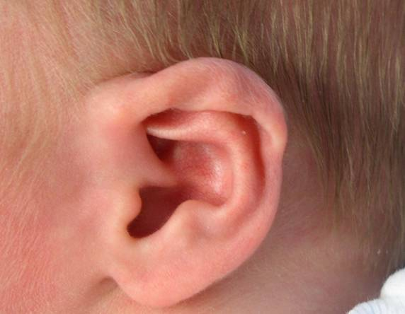
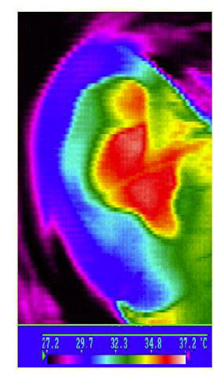
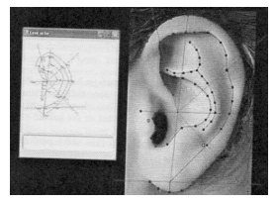
Ear biometry
The individual shape and morphometric structure of the earlobe of each person
Methods:
Morphological relationships
An imprint of bolt structures
Termogram of ear lobe

Slide 63
Verification by reflection of sound in the ear canal
New method
During verification, the person will attach the ear to the loudspeaker - the buzzing.
The sound is reflected from the wall of the ear canal and its part returns to the reflection of the ear wall.
The intensity of sound absorption in the ear canal is individual for every person

Slide 64
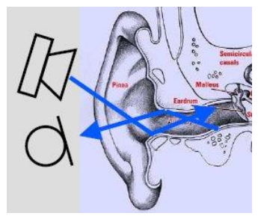
Verification by reflection of sound in the ear canal

Slide 65
Verification according to the shape and movement of the lips
The method is based on the detection of lip movement and uses similar technology as face identification. The camera captures the user's face, and the special software extracts the shape of the lips and records its movement when speaking of the input code that should be individual to each person.

Slide 66
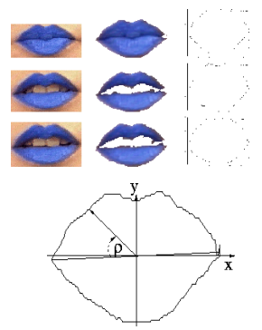
Verification according to the shape and movement of the lips

Slide 67
Identification according to longitudinal crease of nails
Structure of the nail bed
The keratin in the space between the nail and the nail bed was used to identify.
Keratin is a natural polymer that changes the orientation of the incident light
Polarized light at a certain angle - we can capture and analyze phase changes of the beam after reflection from the nail
Notes:
Podélné rýhování nehtů

Slide 68
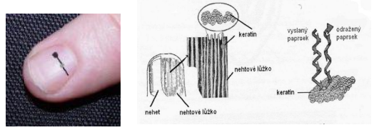
Identification according to longitudinal crease of nails

Slide 69
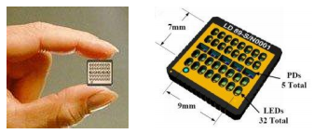
Identification according to skin spectroscopy
Human skin consists of several layers, each layer having a different thickness, and this thickness is uniquely varied in each person, uniquely waved and characterized by other characteristic features.
The selected part of the skin is illuminated by more than one wavelength (from visible to near infrared light).
Each wavelength of light breaks and reflects in another layer of skin and other skin structures. The reflection is captured by a receiver composed of a photodiode and passed for further processing and analysis.
Notes:
Spektroskopie kůže

Slide 70
Biometric Field
Based on the existence of a passive bioelectric field around each person
BIOFINDER II & III - at a distance of 6 meters
The person under test must be self-contained, in the cluster of people it does not work

Slide 71
Biodynamic signature
2006, Idesia company
BioDynamic Signature BDS
Unique are the electrophysiological properties of each person (bioelectric signals)
Based on the electrocardiogram principle

Slide 72
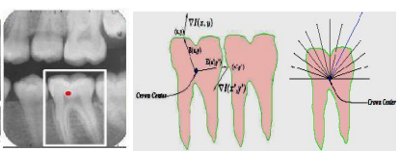
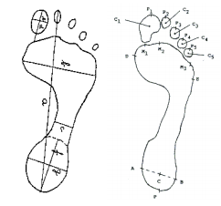
Other methods of biometrics
Identification of firearm user according to grip and push dynamics
Biometric properties of teeth
Identification of the "plantogram" (traces of the bare foot of a human)

Slide 73
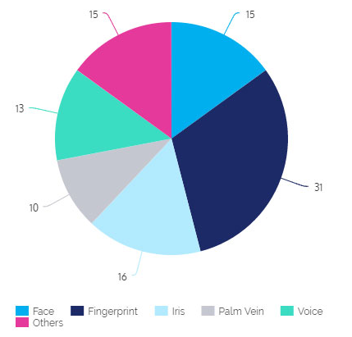
Market of biometric technologies
Source: https://www.bayometric.com

Slide 74
Thank you for attentions…

